Slide 1
HOMEWORK 2 – W4
Capture

Slide 2
Soal
1. Who is manager of employee number 104,105,106,107? and what department they are in?
2. Which top 5 non-managerial employees who has highest salary? and what is their job name?
3. Please show me total employees in each department. And sort them from the least to the most employees.
4. Are there any underpaid/overpaid employees? (Please include managerial role)

Slide 3
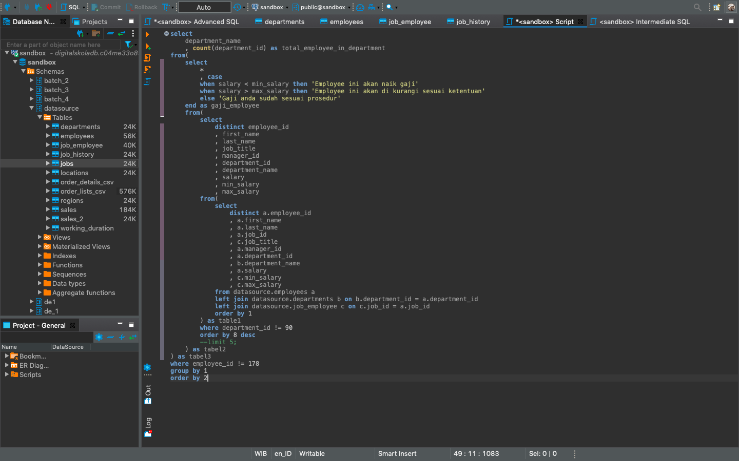
Keseluruhan Syntax

Slide 4
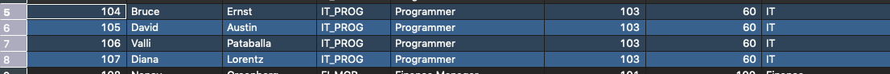
Jawaban No.1

Slide 5
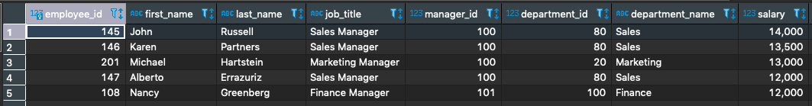
Jawaban No.2

Slide 6
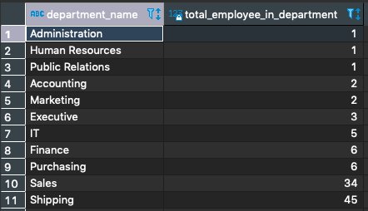
Jawaban No.3

Slide 7
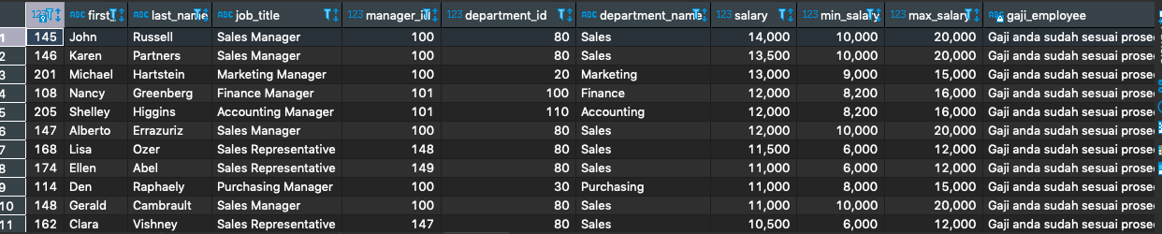
Jawaban No.4

